Slide 1
COMPLEX NETWORKS PROJECT:
LEGAL KNOWLEDGE GRAPH
Athitya Kumar (14ME31005) & Garima Arora (18BM6JP15)

Slide 2
Problem Statement
The Indian judicial system can be modelled as a knowledge graph with nodes being the different acts/legislations that exists in the system, the cases that have been argued in the Courts (their category, subject/topic, the judges who presided over the case etc.) as also information about the judges of the Supreme Courts and High Courts, citation edges between cases and acts and many other features.
In this project, we shall perform several analysis on this knowledge graph.

Slide 3
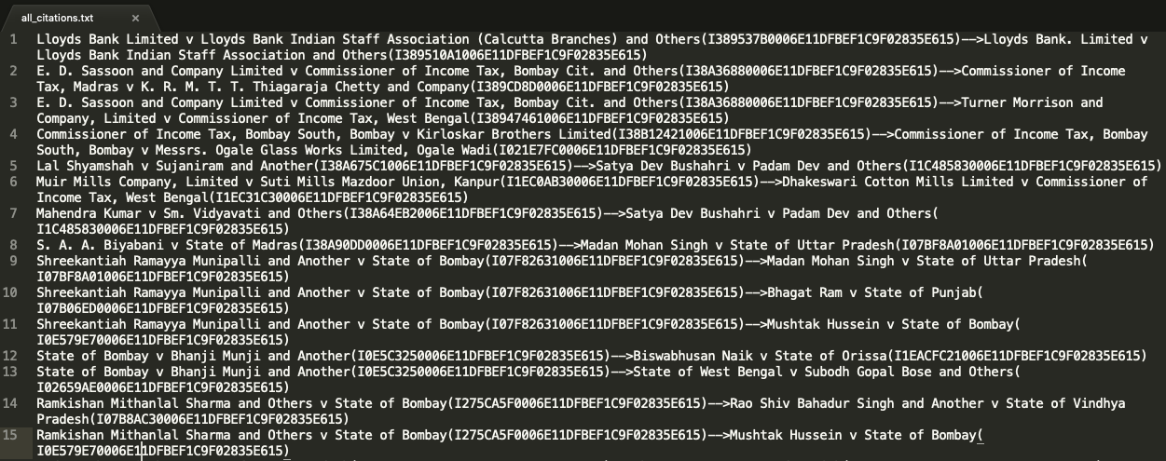
Given Data

Slide 4
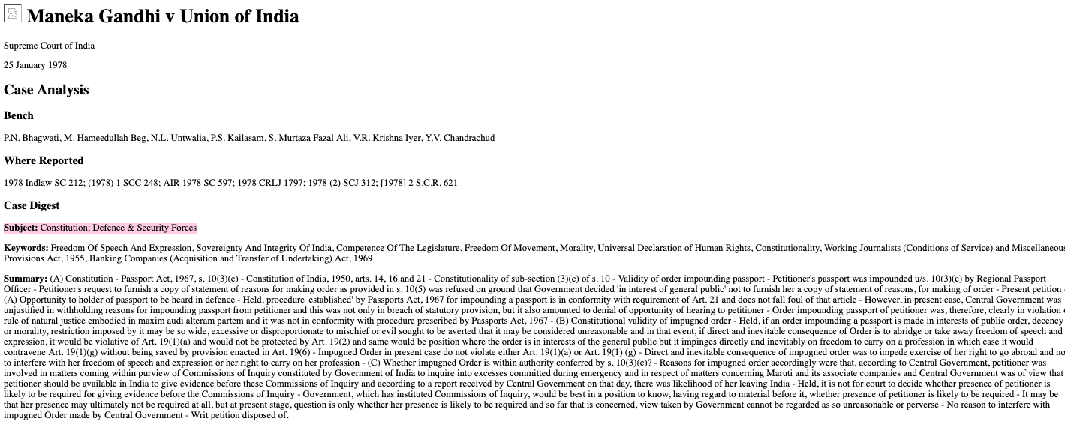
Given Data

Slide 5
Implementation

Slide 6
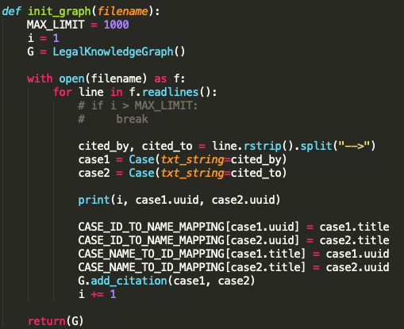
Script to parse Graph

Slide 7
Tasks and Timeline
Task 1
Task 2
Task 3
Extract node title = case name/id
1. Compute different network properties like indegree, outdegree distributions and find if they follow power law?
2. Calculate the clustering coefficient of the network.
3. Calculate the average outdegree, indegree of the cases.
1. Study the centrality measures being to find out important judgments from the paper and replicate them.
2. Report the top 15-20 cases/nodes, based on the different centralities studied.
3. Extract subjects, titles, docID for all the top nodes.
4. Plot the year vs #indgree citation
1. For the top 5 landmark judgements (that comes from the best centrality metric) plot their indegree citations over the years.
2. Extract the subjects & create a list of unique subjects, sorted in decreasing order of their frequency
3. For top 5 unique subjects, plot their frequency in each year.

Slide 8
Tasks and Timeline
Task 4
Task 5
Task 6
1. Extract the acts & create a list of unique acts, sorted in decreasing order of their frequency
2. For top 5 unique acts, plot their frequency in each year.
1. Find which cases appear in top 50 in all the metrics
2. Design a new metric which is cumulative weighted sum of ranks in all the metrics.
See if cases from (1) appear in the top results.
3. Explored k-core and k-shell for possible metrics
1. Find out rich club members. Compare them with the new metric of the weighted rank. The rich club metric is inspired from the “The Network of French Legal Codes, ICAIL 2009” paper.
2. Community detection using k_clique communities in graph.

Slide 9
Results

Slide 10
Preliminary Analysis
Number of Nodes | 32573
Number of Edges | 105378
Average Clustering Coefficient | 0.08839752542011271
Average In-degree | 3.235133392687195
Average Out-Degree | 3.235133392687195

Slide 11
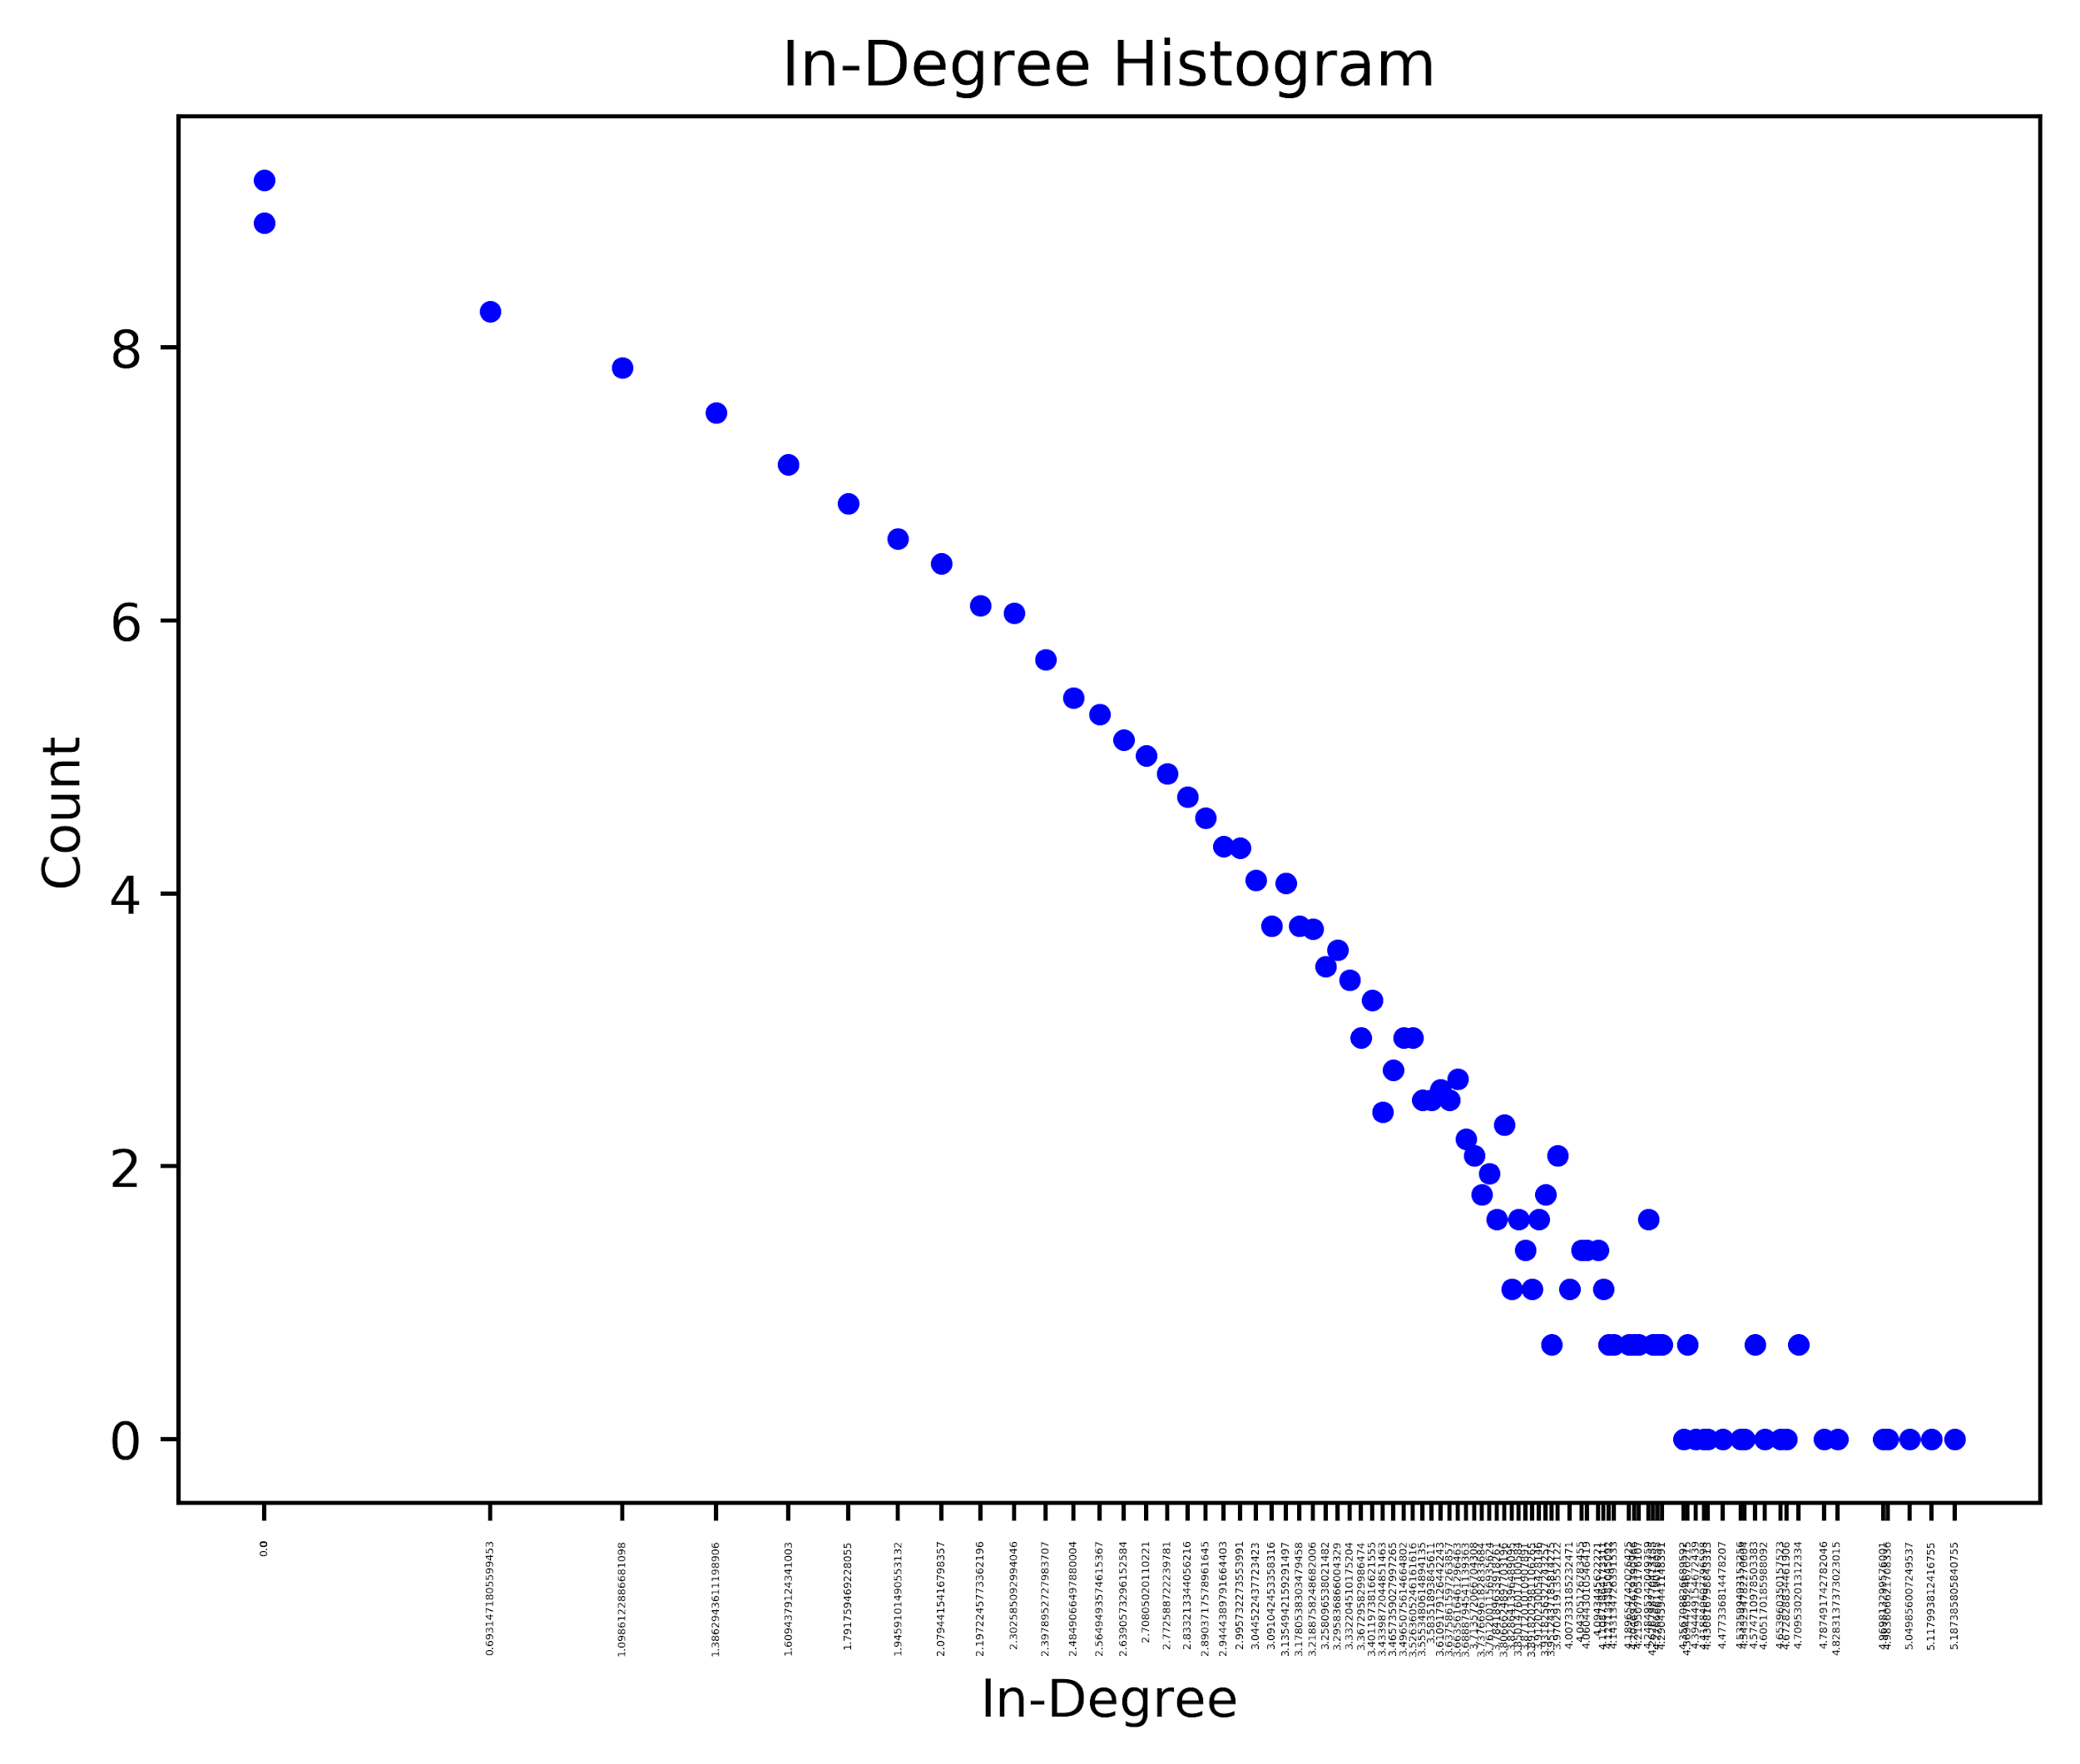
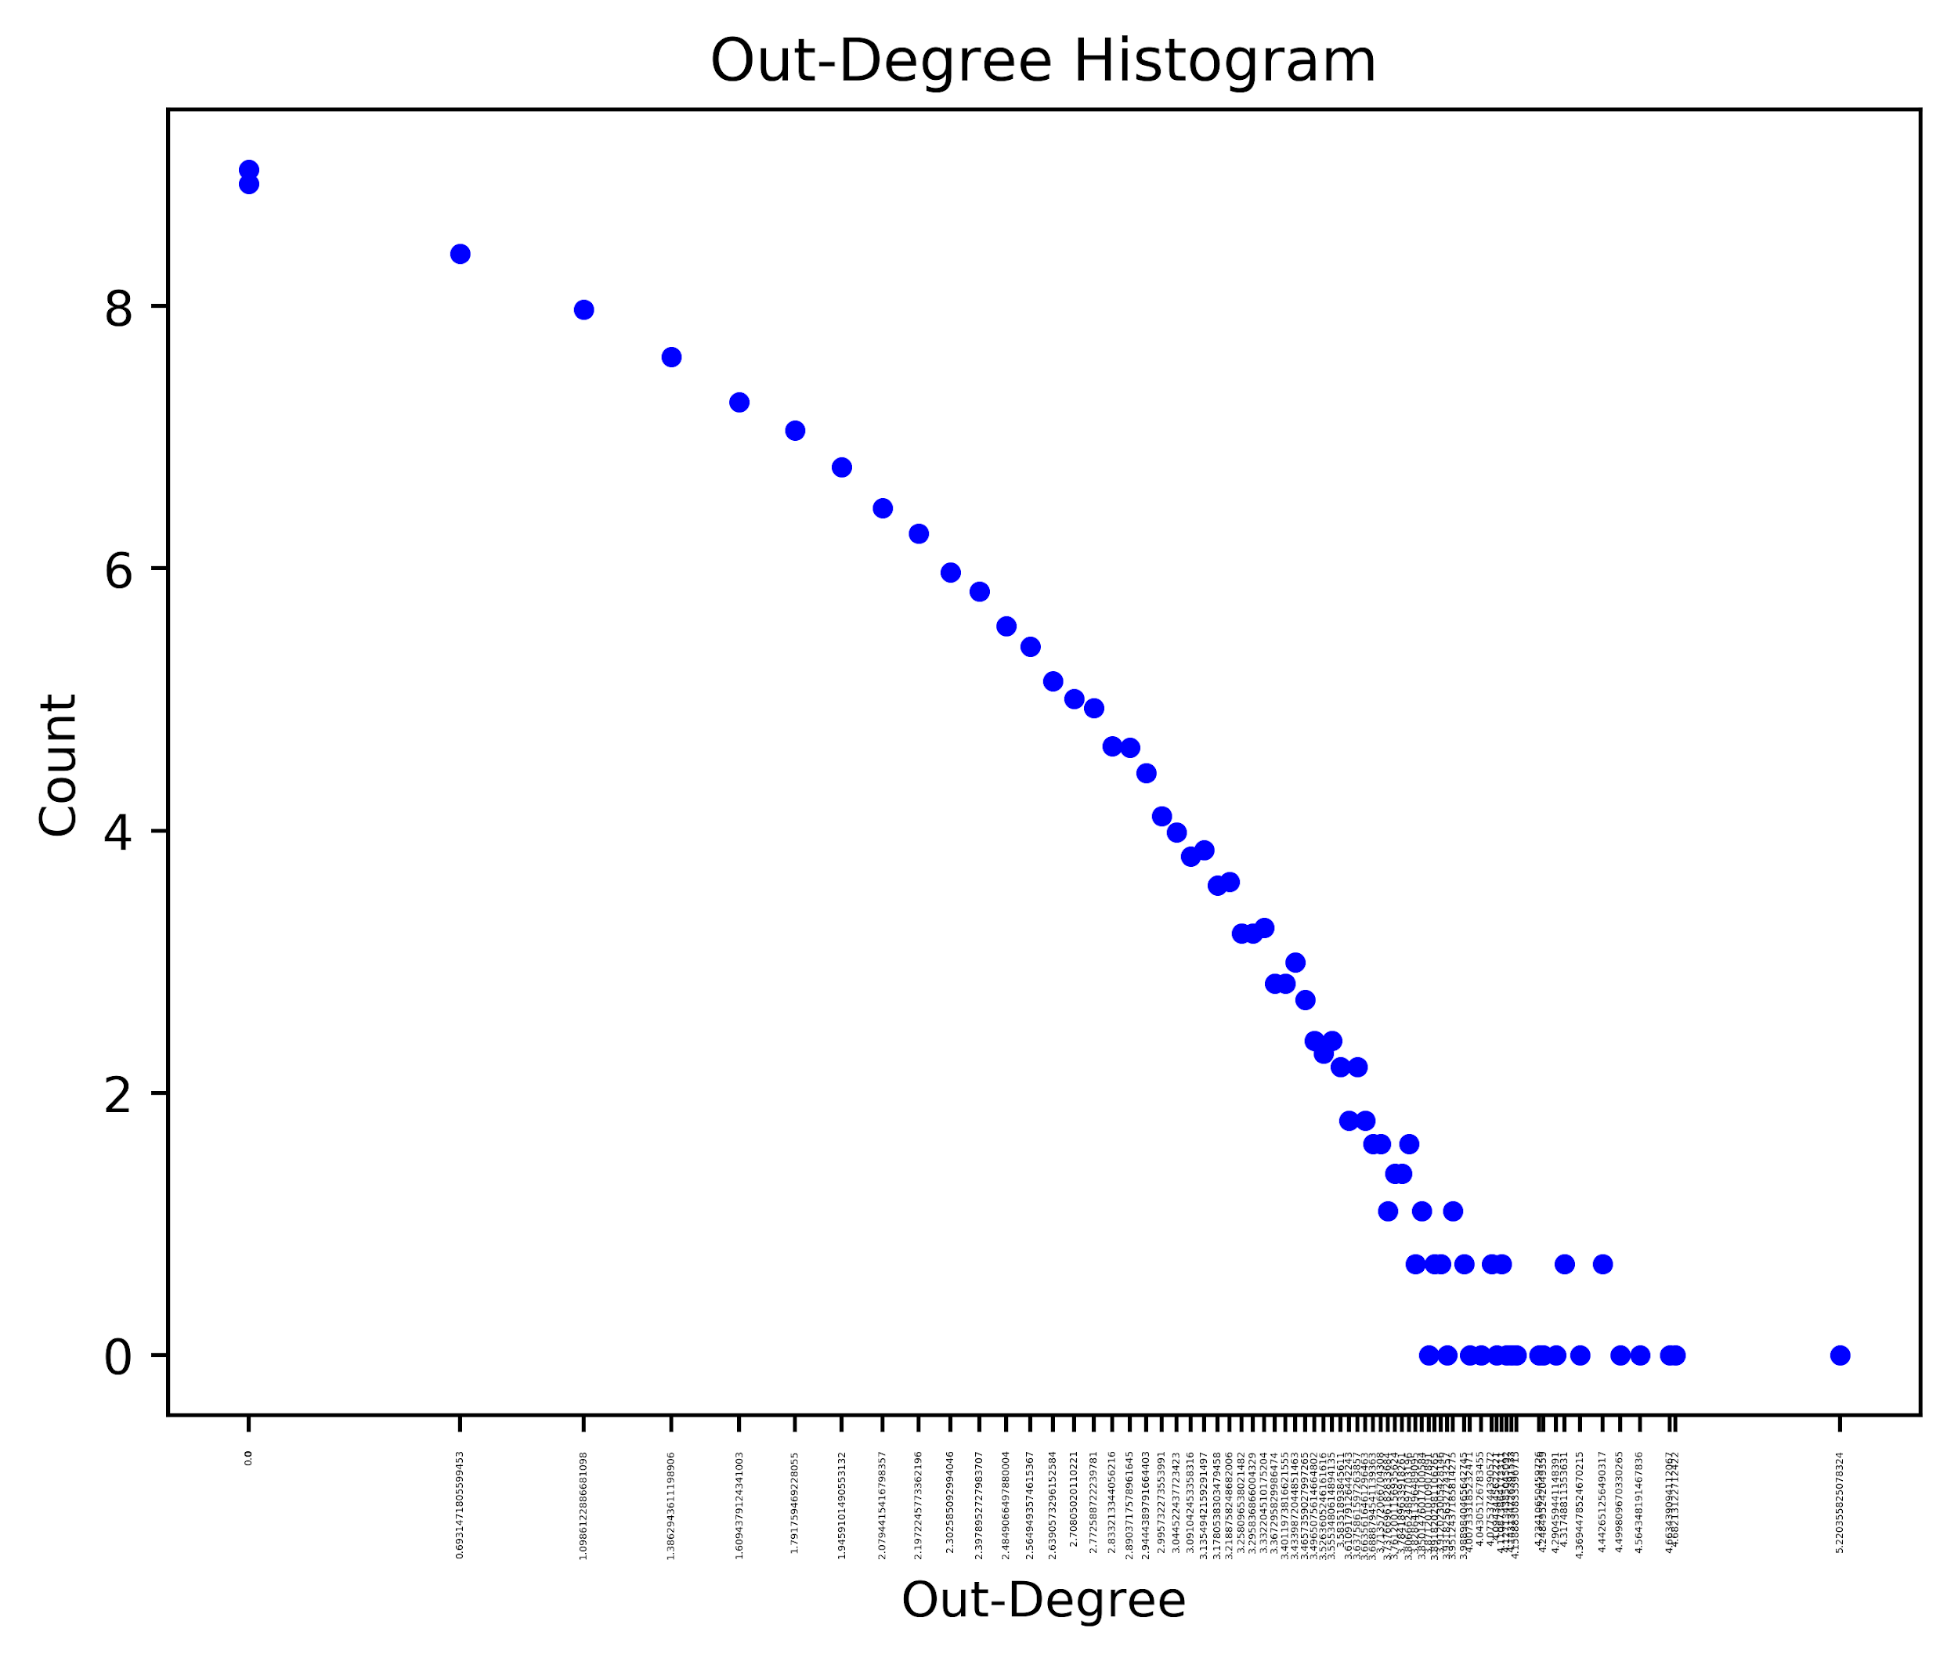
Degree Distributions and Power Law

Slide 12
Degree Centrality Metrics

Slide 13
Indegree Centrality
S No | Case Title | Score
1 | Maneka Gandhi v Union of India | 0.00549551762249785
2 | Bachan Singh Etc. Etc. v State Of Punjab Etc. Etc. | 0.005127103033280117
3 | State of Haryana and Others v Ch. Bhajan Lal and Others | 0.0047893896598305286
4 | Sharad Birdhichand Sarda v State of Maharashtra | 0.0044823775021490845
5 | D. S. Nakara and Others v Union of India | 0.004420975070612796

Slide 14
Eigenvalue Centrality
S No | Case Title | Score
1 | State of Maharashtra v Mayer Hans George | 0.6793025288891708
2 | Indo-China Steam Navigation Company Limited v Jasjit Singh, Additional Collector of Customs and Others | 0.679204457351354
3 | S.Khader Sheriff v Munnuswami Gounder and Others | 0.12927045849649463
4 | Ghasi Ram v Dal Singh and Others | 0.11932004845403985
5 | (1) Bhagwan Datta Shastri v (1) Ram Ratanji Gupta and Others | 0.07954745584856379

Slide 15
Eigenvalue Centrality
S No | Case Title | Score
1 | State of Maharashtra v Mayer Hans George | Foreign Exchange, Sea Customs Act
2 | Indo-China Steam Navigation Company Limited v Jasjit Singh, Additional Collector of Customs and Others | Foreign Exchange, Sea Customs Act
3 | S.Khader Sheriff v Munnuswami Gounder and Others | Election laws, Corrupt practices of candidates
4 | Ghasi Ram v Dal Singh and Others | Election laws, Corrupt practices of candidates
5 | (1) Bhagwan Datta Shastri v (1) Ram Ratanji Gupta and Others | Education related, schools

Slide 16
Katz Centrality
S No | Case Title | Score
1 | Bachan Singh Etc. Etc. v State Of Punjab Etc. Etc. | 0.13189964881417063
2 | Maneka Gandhi v Union of India | 0.13008808947547434
3 | Ramana Dayaram Shetty v International Airport Authority of India and Others | 0.08725873729749872
4 | Machhi Singh And Others v State Of Punjab | 0.08220944845645818
5 | State of Haryana and Others v Ch. Bhajan Lal and Others | 0.08158000380174614

Slide 17
Pagerank Centrality
S No | Case Title | Score
1 | Maneka Gandhi v Union of India | 0.001282150863812228
2 | Union of India v Delhi Cloth and General Mills | 0.000950502787704255
3 | State of Haryana and Others v Ch. Bhajan Lal and Others | 0.0009347125115636144
4 | State of Orissa v Dr. (Miss) Binapani Dei and Others | 0.00093033417893008
5 | D. S. Nakara and Others v Union of India | 0.00091175367166077

Slide 18
Closeness Centrality
S No | Case Title | Score
1 | Maneka Gandhi v Union of India | 0.07130285579464027
2 | Budhan Choudhry and Others v State of Bihar | 0.05335523968204196
3 | Board of High School and Intermediate Education v Ghanshyam Das Gupta and Others | 0.05073714203979647
4 | Rustom Cavasje Cooper and another v Union of India | 0.04995369503649483
5 | A. K. Kraipak and Others v Union of India and Others | 0.049713243969718046

Slide 19
Inward Relevance Centrality
S No | Case Title | Score
1 | (1) Mukesh and another; (2) Vinay Sharma and another v State for (NCT of Delhi) and others | 0.18416098342358436
2 | Rameshbhai Chandubhai Rathod v State of Gujarat | 0.17595702764329468
3 | State Of Goa v Pandurang Mohite | 0.15012179448039575
4 | Mohan Anna Chavan v State of Maharashtra | 0.14280662180983208
5 | Bantu v State of Uttar Pradesh | 0.14045645274621338

Slide 20
Inward Relevance Centrality
S No | Case Title | Summary
1 | (1) Mukesh and another; (2) Vinay Sharma and another v State for (NCT of Delhi) and others | Nirbhaya gangrape case important judgment which is likely to form the basis for several criminal law decisions in the future.
2 | Rameshbhai Chandubhai Rathod v State of Gujarat | Related to death penalty for rape and murder of children
3 | State Of Goa v Pandurang Mohite | Kidnap and murder of a young kid
4 | Mohan Anna Chavan v State of Maharashtra | Related to death penalty for rape and murder of children
5 | Bantu v State of Uttar Pradesh | Related to death penalty for rape and murder of children

Slide 21
Outward Relevance Centrality
S No | Case Title | Score
1 | Sharad Birdhichand Sarda v State of Maharashtra | 0.3635457349128727
2 | Bachan Singh Etc. Etc. v State Of Punjab Etc. Etc. | 0.2838390902415921
3 | Earabhadrappa Alias Krishnappa v State of Karnataka | 0.26301762234677023
4 | Padala Veera Reddy v State of Andhra Pradesh and Others | 0.2610678122400449
5 | C. Chenga Reddy and Others v State of Andhra Pradesh | 0.2592522172570593

Slide 22
Outward Relevance Centrality
S No | Case Title | Summary
1 | Sharad Birdhichand Sarda v State of Maharashtra | circumstantial evidence
2 | Bachan Singh Etc. Etc. v State Of Punjab Etc. Etc. | death penalty
3 | Earabhadrappa Alias Krishnappa v State of Karnataka | death sentence
4 | Padala Veera Reddy v State of Andhra Pradesh and Others | circumstantial evidence , death penalty
5 | C. Chenga Reddy and Others v State of Andhra Pradesh | circumstantial evidence , death penalty

Slide 23
Common cases found in all the metrics
S No | Case Title | Common in...
1 | Maneka Gandhi v Union of India | 5
2 | Bachan Singh Etc. Etc. v State Of Punjab Etc. Etc. | 4
3 | Sharad Birdhichand Sarda v State of Maharashtra | 4
4 | D. S. Nakara and Others v Union of India | 4
5 | Ramana Dayaram Shetty v International Airport Authority of India and Others | 4

Slide 24
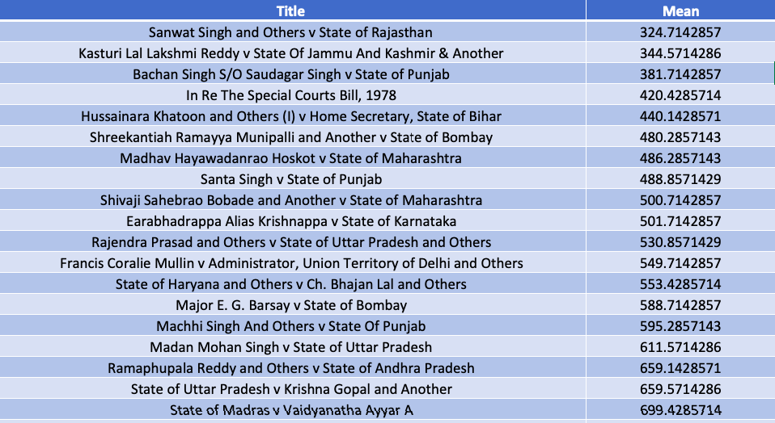
Weighted Rank Metric (using Arithmetic mean)

Slide 25
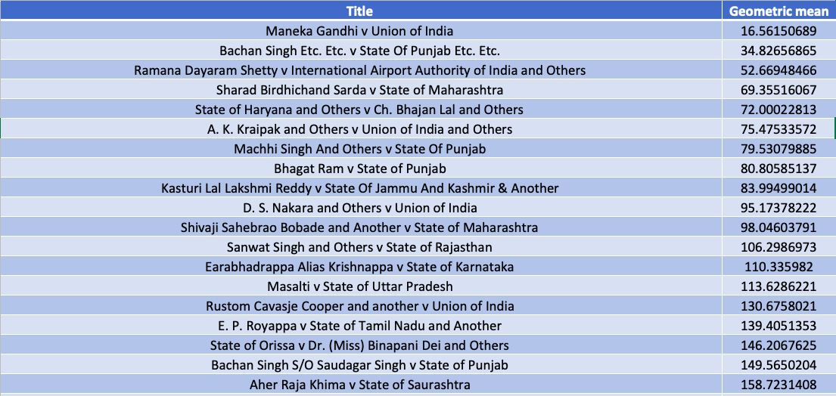
Weighted Rank Metric (using Geometric mean)

Slide 26
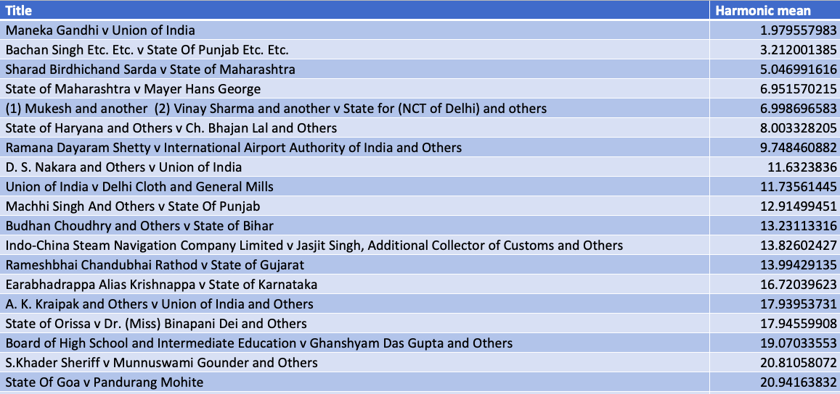
Weighted Rank Metric (using Harmonic mean)

Slide 27
Analysis on Case Files

Slide 28
Given Case Data

Slide 29
Subjects (Total:64)
All Subjects
Top 5 Subjects:
Practice & Procedure, Criminal, Constitution, Land & Property, Labour & Industrial Law, Service, Civil Procedure, Indirect Tax, Income Tax & Direct Taxes, Corporate, Excise, Municipalities & Local Governments, Family & Personal, Customs, Rent Control, Sales Tax, Banking & Finance, Carriers & Transportation, Arbitration & ADR, Administrative, Contract & Commercial
and so on...
S No | Subject | # of cases
1 | Practice & Procedure | 13,272
2 | Criminal | 12,633
3 | Constitution | 6,478
4 | Land & Property | 6,249
5 | Labour & Industrial law | 6,087

Slide 30
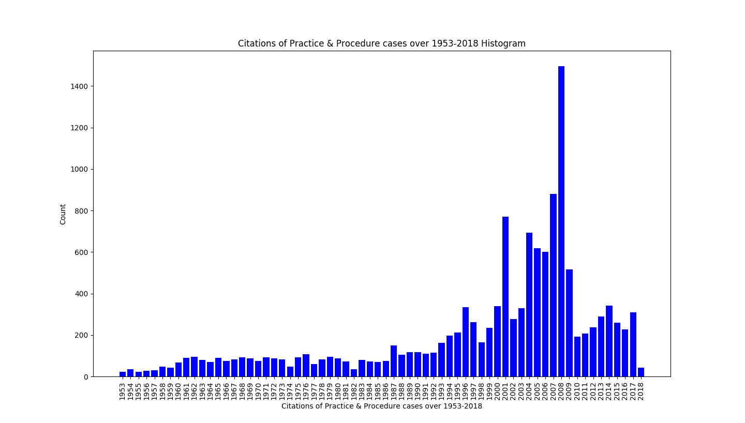
Citations of Practice and Procedure cases over 1953-2018

Slide 31
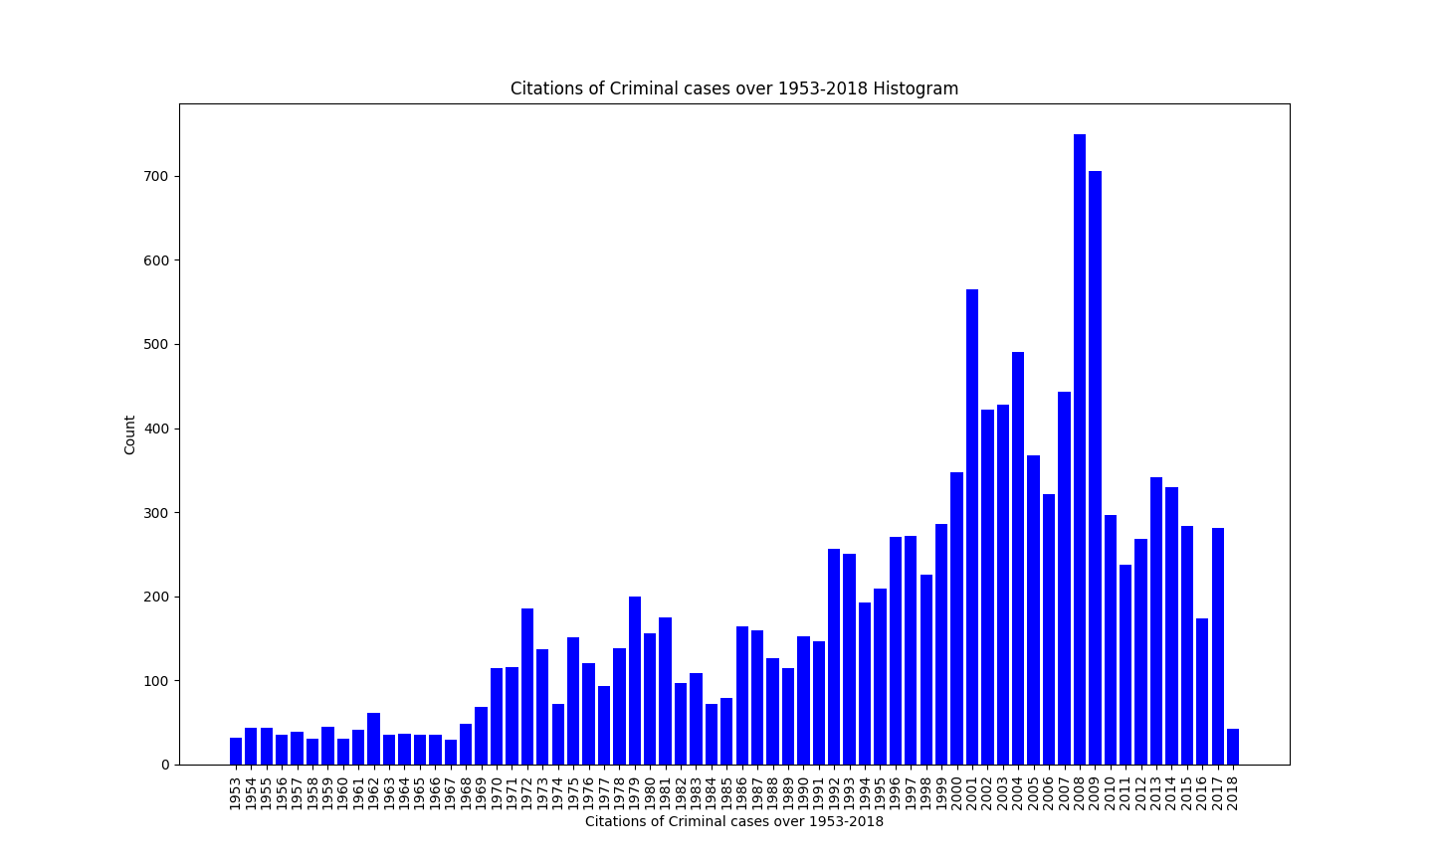
Citations of Criminal cases over 1953-2018

Slide 32
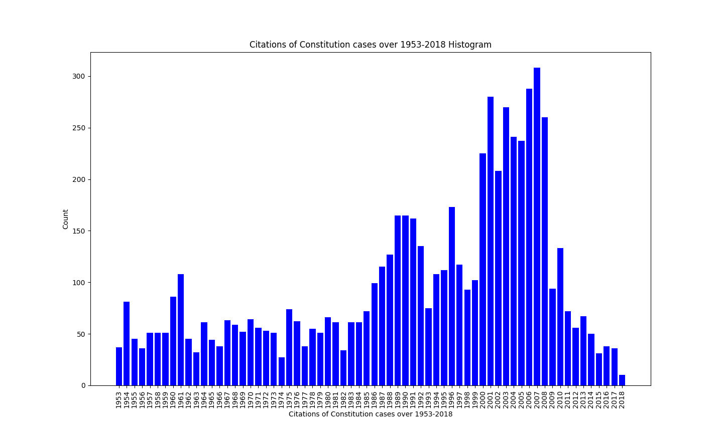
Citations of Constitution cases over 1953-2018
Citations of Criminal cases over 1953-2018

Slide 33
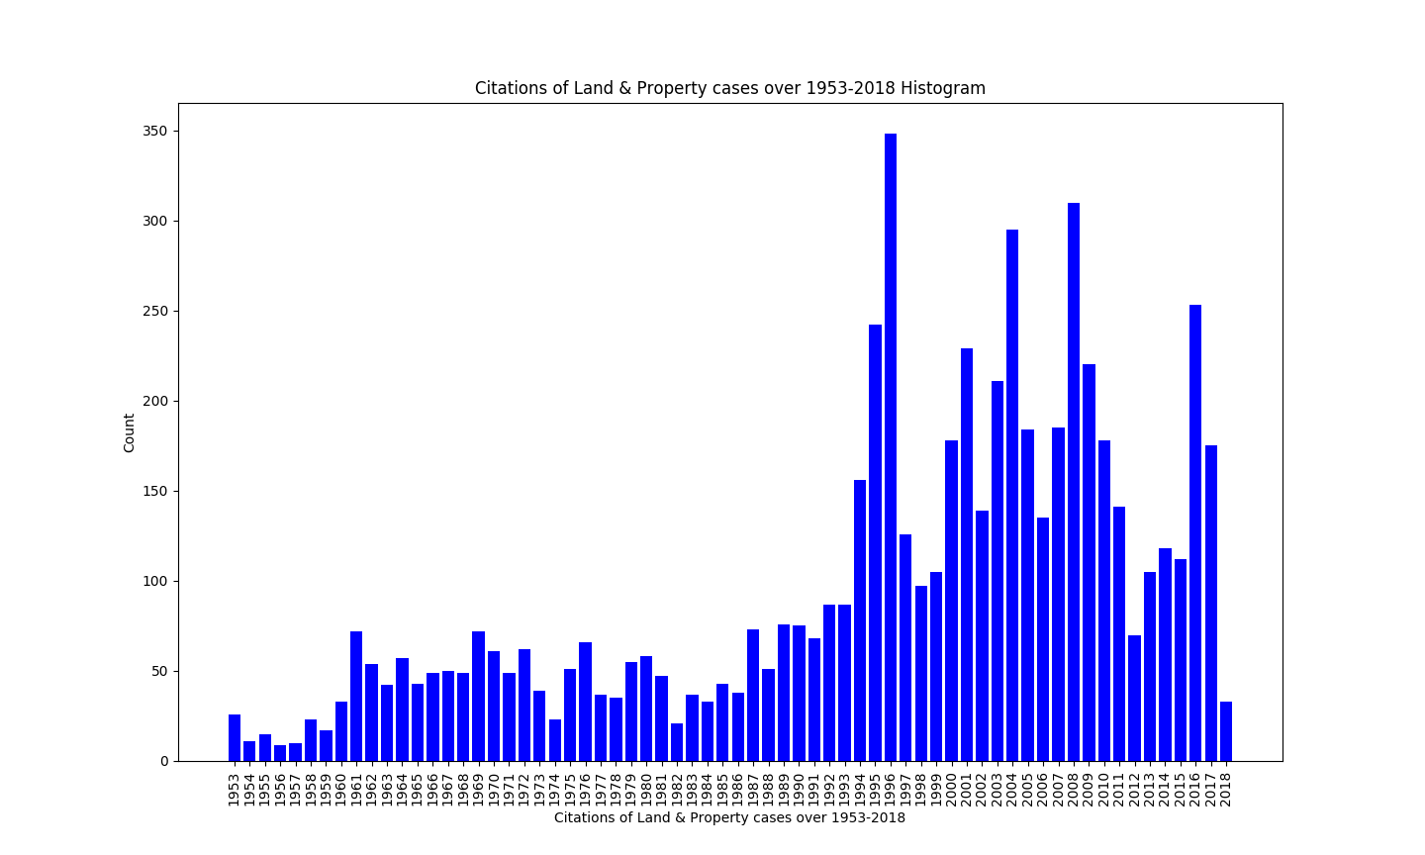
Citations of Land and Property cases over 1953-2018

Slide 34
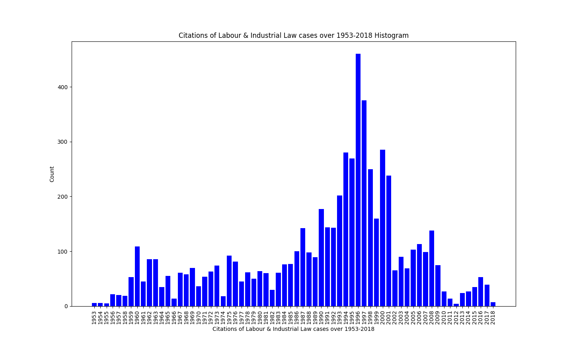
Citations of Labour and Industrial Law cases over 1953-2018

Slide 35
Analysis on Acts of the Indian Judicial System

Slide 36
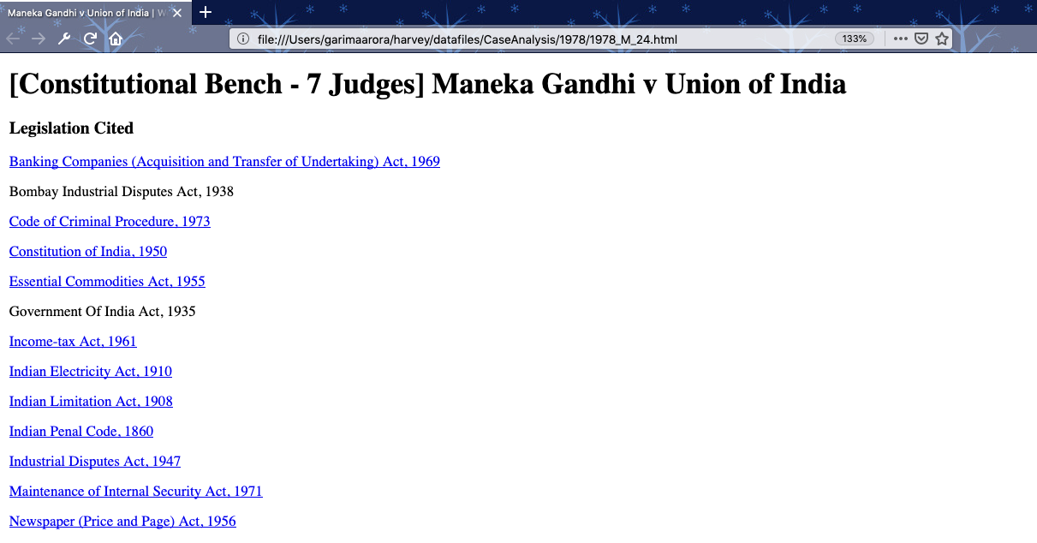
Given Acts Data

Slide 37
Acts (Total: 55,279)
All Acts
Top 5 Acts:
Income-tax Act, 1961
Indian Electricity Act, 1910 Indian Limitation Act, 1908
Indian Penal Code, 1860
Industrial Disputes Act, 1947
Maintenance of Internal Security Act, 1971
Newspaper (Price and Page) Act, 1956
Passports Act, 1967
and so on...
S No | Subject | # of cases
1 | Constitution of India, 1950 | 14,079
2 | Indian Penal Code, 1860 | 8,432
3 | Code of Criminal Procedure, 1973 | 5,634
4 | Code of Civil Procedure, 1908 | 4,810
5 | Indian Penal Code, 1860 s. 302 | 2,618

Slide 38
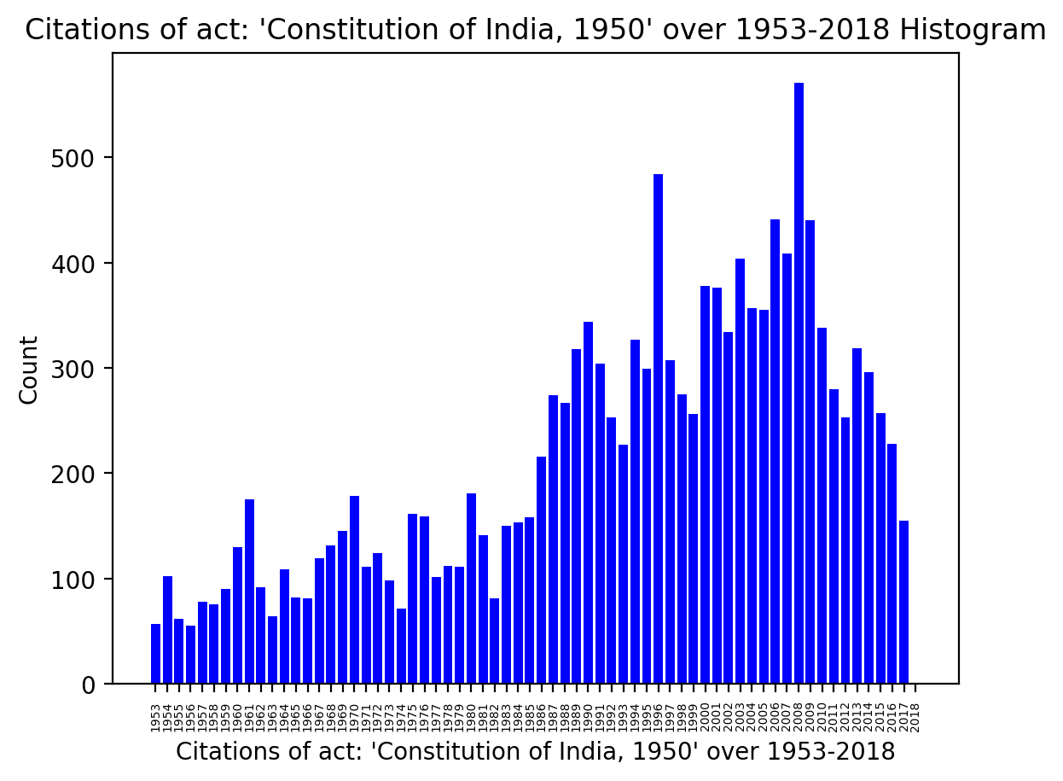
Citations of Act: ‘Constitution of India, 1950’ over 1953-2018

Slide 39
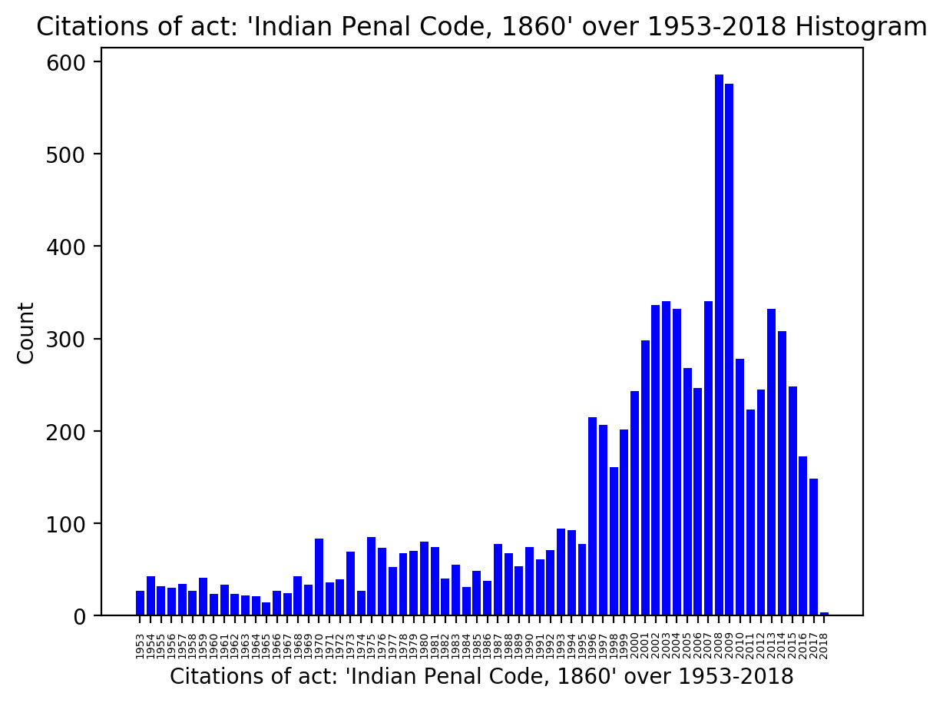
Citations of Act: ‘Indian Penal Code, 1860’ over 1953-2018
Citations of Criminal cases over 1953-2018

Slide 40
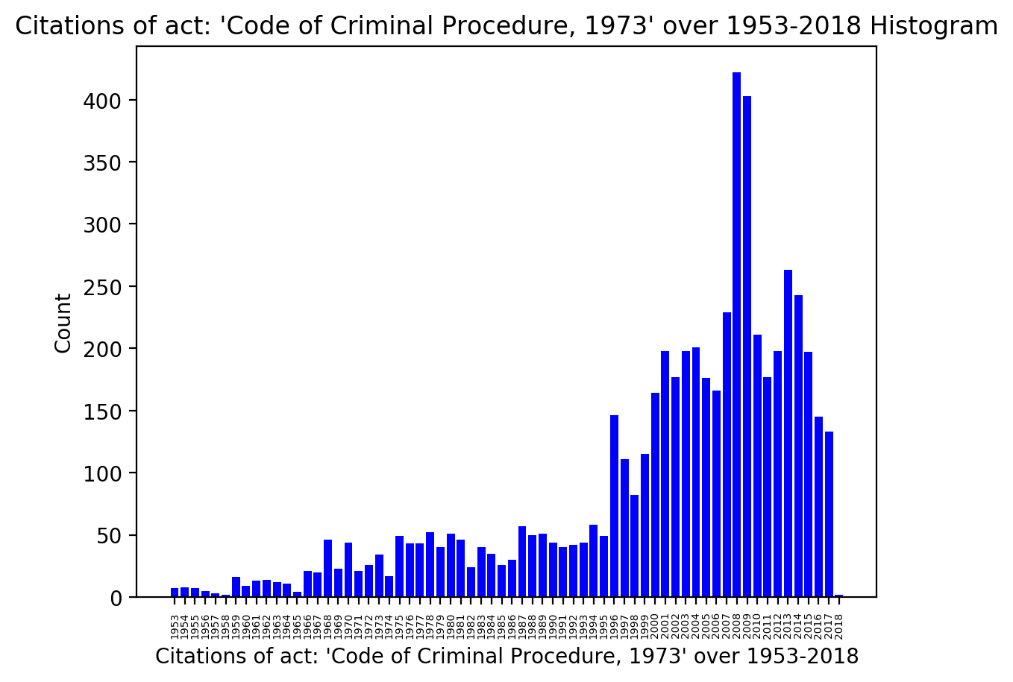
Citations of Act: ‘Code of Criminal Procedure, 1973’ over 1953-2018

Slide 41
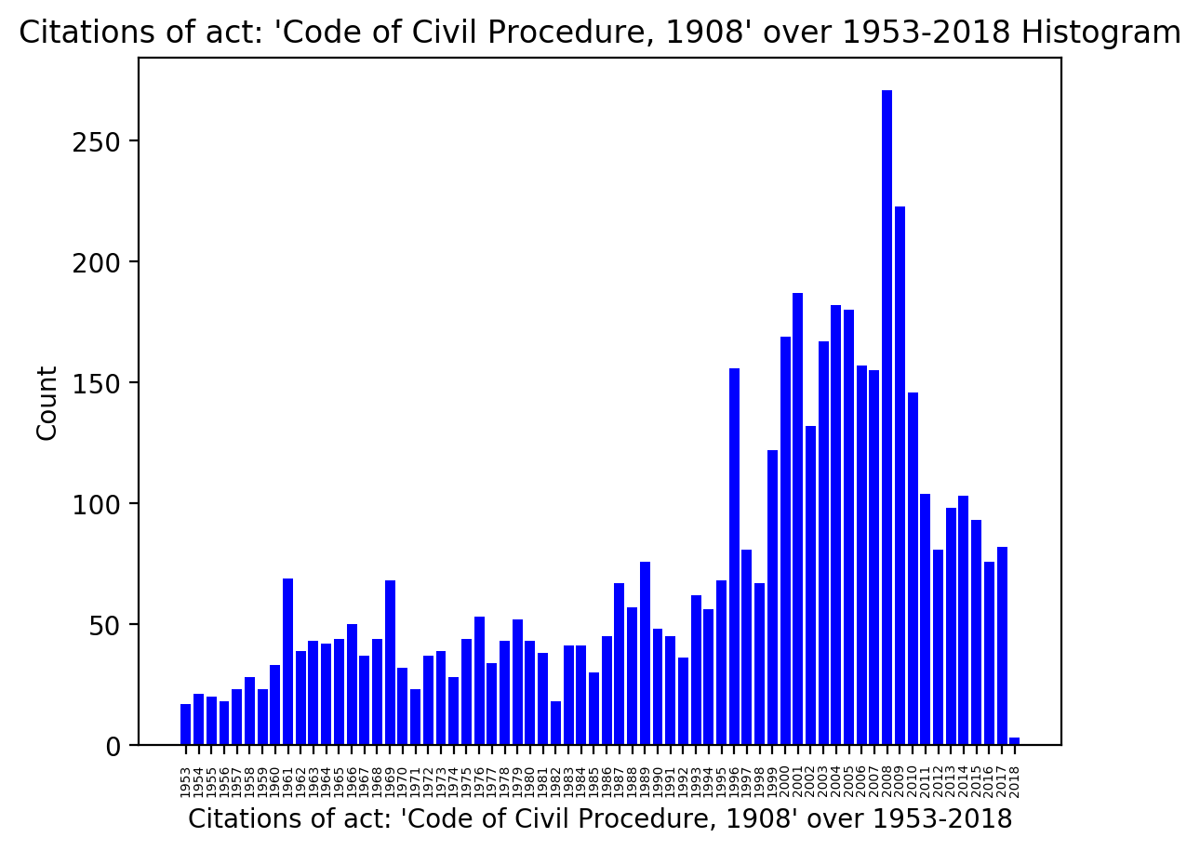
Citations of Act: ‘Code of Civil Procedure, 1908’ over 1953-2018

Slide 42
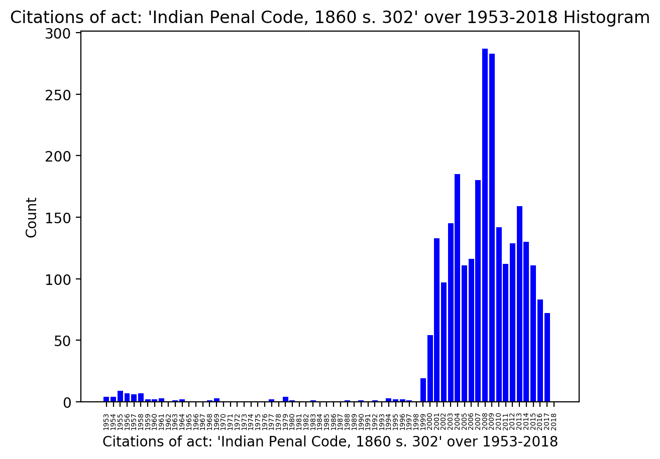
Citations of Act: ‘Indian Penal Code, 1860 s. 302’ over 1953-2018

Slide 43
K-Core (K=14, cases=28)
S No | Case Title
1 | State of Rajasthan v Yusuf
2 | State Of Punjab v Sukhchain Singh & Anr.
3 | Valson And Anr. v State Of Kerala
4 | Bhim Singh Rup Singh v State of Maharashtra
5 | State Of Goa v Pandurang Mohite

Slide 44
K-Shell (K=14, cases=28)
S No | Case Title
1 | State of Rajasthan v Yusuf
2 | State Of Punjab v Sukhchain Singh & Anr.
3 | Valson And Anr. v State Of Kerala
4 | Bhim Singh Rup Singh v State of Maharashtra
5 | State Of Goa v Pandurang Mohite

Slide 45
K-Corona (K=10, cases=40)
S No | Case Title
1 | Ranveer Singh v State Of M.P
2 | Mohd. Chaman v State
3 | Lehna v State of Haryana
4 | Union of India v R. Sethumadhavan and another
5 | UCO Bank and others v Rajendra Shankar Shukla

Slide 46
Rich Club
S No | Case Title
1 | Maneka Gandhi v Union of India
2 | Bachan Singh Etc. Etc. v State Of Punjab Etc. Etc.
3 | State of Haryana and Others v Ch. Bhajan Lal and Others
4 | Sharad Birdhichand Sarda v State of Maharashtra
5 | D. S. Nakara and Others v Union of India

Slide 47
Rich Club (contd.)
S No | Case Title
6 | Ramana Dayaram Shetty v International Airport Authority of India and Others
7 | Machhi Singh And Others v State Of Punjab
8 | (1) Mukesh and another; (2) Vinay Sharma and another v State for (NCT of Delhi) and others

Slide 48
Community detection with K-Clique: community #1
S No | Case Title | Subjects
1 | Augustine Saldanha v State Of Karnataka | Criminal
2 | Daya Nand v State of Haryana | Criminal
3 | Thangaiya v State Of Tamil Nadu | Criminal, Practice & Procedure
4 | Abbas Ali v State Of Rajasthan | Criminal, Practice & Procedure

Slide 49
Community detection with K-Clique: community #1 (contd.)
S No | Case Title | Subjects
5 | Kalarimadathil Unni v State of Kerala | Criminal
6 | Rajinder v State of Haryana | Criminal, Defence & Security Forces, Practice & Procedure
7 | State of Andhra Pradesh v Rayavarapu Punnayya and Another | Criminal, Tort
8 | Virsa Singh. v The State Of Punjab | Criminal

Slide 50
Inferences
Out of the 7 centrality metrics, Eigenvector, Katz & Inward relevance centrality results are seen to be a bit different, compared to other centrality measures.
In the weighted-rank metric, the HM & GM approaches give more relevant results in comparison to overlapping results.
AM is more prone to outliers by individual ranks, and is affected much more than HM & GM.

Slide 51
Inferences
Community detection results using K-cliques, could be validated with their corresponding subjects.ld
K-core, K-shell, K-corona results don’t seem to be interpretable/meaningful.
We found most popular cases, subjects, acts, and even plotted their variation over the years.
The most popular cases detected by Rich club, are also found to be in accordance with our weighted-rank metric.

Slide 52
Thank you

